Slide 1

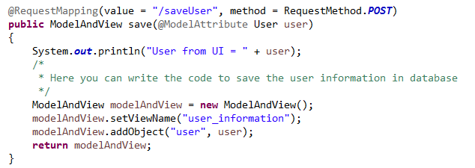
Spring Boot Thymeleaf View
Thymeleaf is a server side Java template engine for web application.
Thymeleaf can be integrate with Spring Framework and ideal for HTML5 Java web applications.

